Slide 1
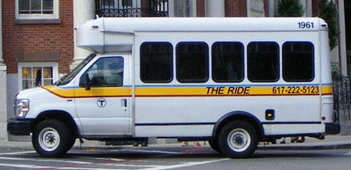
MBTA The Ride
Team 204
Michael Fleischmann, Sarah Chou, Olivia Schlepphorst, Lindsay Hauser, Sophie Wigmore
Notes:
Why Python?
SOOO many reasons: geocoding libraries, json and csv libraries, google tools.
Added benefits afterwards: Flask
Added negatives: Setting up Jenkins, not all of us know
How did you work differently/better since we had 5 people -> gave us a more centralized focus & we were able to
How do we know our algorithm is good

Slide 2

The Goal
Cut costs, maximize efficiency for the MBTA’s The Ride Service by optimizing their routing system
Boost ridesharing services and productivity
Notes:
The main goal was to provide our client, MBTA’s The Ride Service, with an optimized routing system that cuts costs and maximizes efficiency, while boosting ridesharing services and productivity, or the number of customers per hour the vehicle is on the road.

Slide 3



Our Process
Communication
iMessage
Git
Google drive
Meeting times increased as the project progressed
Notes:
In terms of our process, our main means of communication was iMessage, which worked out nicely because we all have Macs. We stored all of our meeting notes and other documents in git. We used google drive to create documents such as goals for each sprint and test specs which we would then transfer to Jira to create tickets for each sprint.
We got off to a somewhat slow start, probably meeting max once a week in the beginning, and by sprint 5 we were meeting almost every day and sometimes twice a day.

Slide 4

Sprint Outline
SPRINT 1: Project description, use cases, UI paper prototypes
SPRINT 2: Java, UML diagrams, research, usability study, skeleton of UI coding
SPRINT 3: Bare bones code for algorithm in Java, more research, routing calculator unit tests, teamed up with 210
SPRINT 4: Python, majority of development, testing for all classes
SPRINT 5: Finished algorithm, finished testing, set up MOC and Jenkins, connected to front end, packaging/handoff
Notes:
Here is an outline of our sprints. We started off sprint 1 with general project planning.
In sprints 2 and 3 we did more planning and started research, and moved into tests and bare bones code.
In sprint 3 we also decided to merge with team 210, so that they could do the front end and connect with our algorithm.
In sprint 4 we decided to switch to Python because it was easier to use the google optimization tools (which we will get into more later, in terms of the pros and cons of doing so), and this sprint consisted of most of the development for this project, alongside the development of tests.
Sprint 5 was probably our most productive sprint, where we completed the algorithm, finished testing, set up MOC and Jenkins, connected to team 210’s front end and got everything to communicate nicely, and decided how to package and handoff.

Slide 5
Roles
Sophie
Sarah
Lindsay
Olivia
Michael
Planning
Requirements
UML
Use Cases
Research
Algorithm Functionality
Testing
Routing Calculations
Parsing input
Code Coverage
Logistics
Connect with front end
Jenkins/MOC
Notes:
Since we were mainly focused on the back end, we found it most helpful to meet together and work as a group to separate tasks to each person.
At the beginning of the sprints, all five of us were involved in the initial project planning steps such as doing the requirements, participating in the client meetings, making UML diagrams, use cases, and researching technologies such as geocoding APIs and what languages to use. This was helpful to make sure we were all on the same page and to balance out how much work each member had.
In terms of algorithm functionality, Michael, Lindsay, and Olivia worked closely to get that done. More details on the algorithm will be given in a few minutes.
Before, during, and after the inception of the algorithm functionality, myself, Sarah, Lindsay, and Olivia wrote many tests, which I will outline later in the presentation. This helped to get an idea of what we wanted our algorithm to spit out, and was helpful to measure our progress throughout the sprints.
Lastly, there were logistical tasks that often got put on the back burner during the sprints such as actually connecting our back end with the front end, which Michael accomplished during our meetings with group 210 in the last sprint. Olivia handled a lot of the configurations involving Jenkins and MOC with Alex which proved to be a challenge since we used Python.
While we all had separate roles and tasks to do, it was very helpful to do a lot of the work all together as a group, which helped bounce ideas and address issues as a group as the arose, and to get a sense of the overall group progress. This definitely fostered our increased productivity towards the end of the sprints.

Slide 6





Tech Stack
Originally planned to use Java, switched to Python
Deployed on Mass Open Cloud
Use of Python Libraries such as Google Optimization Tools (for route calculation) and PANDAS for data parsing
Notes:
Lindsay
We used python for the back end, flask to communicate with the front end, git for source control and documentation, jira for sprint planning and organization of work tickets, jenkins for continuous integration, and mass open cloud to deploy.
We originally planned to use Java because that was the only language that all of us had had experience with. However, Michael had had some experience with python, and realized that tasks such as file parsing and geocoding were much easier in python than java. We switched to using python, but we didn’t lose that much work. We had only worked on creating unit tests in Java and setting up the skeleton of the back end (no actual code) and when we switched over, we just adapted the unit tests into python. Python has a very similar unit test framework as Java’s junit. We especially made use of libraries such as google optimization tools to help us solve routing and PANDAS to help with data parsing.

Slide 7
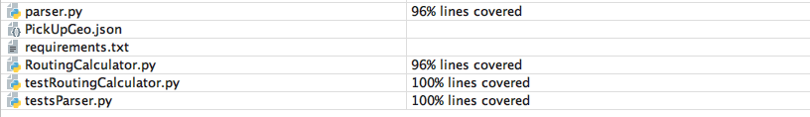
Testing
Wrote tests before coding algorithm
Test Specs - helped organization and covering all cases
Focused on Routing Calculator and Time Windows
Parser tests - harder to validate
Helped illuminate bugs in our code
Notes:
At first, we chose to use Java since we all knew it. Because of this, we originally wrote a few general tests in Java before we had any actual code written. When we switched to Python, we transferred these existing tests to work.
We created a plethora of test spec documents to test different aspects of our functionality, and used these to separate all of the tests we needed. The test specs proved to be very helpful for organization, and making sure we had verbose tests. We housed these documents in Github. The primary tests we focused on at the beginning were for routing output and time windows to make sure once the algorithm we had was outputting what we wanted. We also wrote Parser tests which were harder to figure out, but were necessary to validate the input was correctly geocoded and passed into the Routing Calculator.
Writing tests throughout the sprints was extremely helpful in illuminating lurking bugs in our code that we wouldn’t have noticed otherwise. We took a handful of ride requests, and hand calculated routes and ride sharings to be algorithms, so we could test that our algorithm was spitting out results that we were confident to be optimal. This helped us to know that our routes are good.
Additionally, code coverage reports were invaluable during the testing process in that we found that we weren’t hitting every line, and forced us to think about different ways to try to break our code or reach these statements. We ended up with about 96% line coverage.

Slide 8
The Vehicle Routing Problem
We researched the problem and found out everything we needed to know
VPR is a classic algorithm that was solved in the 50s
Considered NP-Hard
Goods need to be picked up and delivered to locations by different vehicles
How do we optimize this?

Slide 9
The Algorithm
We used Google Optimization Tools to implement the algorithm
Parsed through data and created different dimensions including:
Earliest and Latest window times
Distances between points (Great-circle)
Vehicle capacity
Conducted tests to make sure the algorithm worked as planned
The algorithm turned out to be N^2
Notes:
Michael

Slide 10
DEMO TIME!
Notes:
Michael

Slide 11
Handoff
Everything in our team’s Github repository
Documents: Usability write-ups, Use Cases, README
Code: All code and tests written
Backend is configured with Flask, provide info on how to set up.
Package with 210
Notes:
Lindsay
In terms of handoff, we will make everything in our github repository available to the client. Our repository contains all documentation, which includes all of our meeting notes, usability study write ups, and use cases under a documentation folder. We will also handoff all code and tests to the client.
The backend connects to the frontend with Flask, and currently it is set up. As long as the server is running on mass open cloud, our endpoint is accessible. And in the README

Slide 12
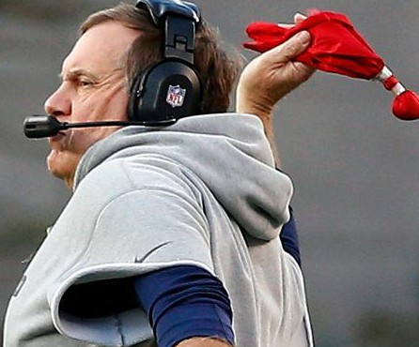
Challenges
Finding times and places for all of us to meet
Difficult to split up working on the algorithm
Google maps API has limitations
Integrating Jenkins with Python
Learning curve
Notes:
Sarah
Challenges:
With a group of 5 very busy people it was hard to schedule times to meet, as well as find quiet places on campus for us to meet up and work
It was difficult to split up working on the algorithm
The google maps API limits us at 2,500 requests per day
Jenkins didnt have any of the python dependencies
There was a learning curve, as most of the members in our group were not familiar with Python and so we had to put in additional time and effort into learning
Solutions:
As the semester progressed, we got better at meeting up, and utilized applications such as doodle polls to see when people were free to meet up, and NUSSO for space scheduling, so we could save time by booking a room instead of walking around campus looking for an empty room
We split up the work in other ways, so if people were not working on the algorithm, they would be creating test specs and writing tests, or meeting with TAs to figure out how to use jenkins or Mass Open Cloud - we made sure that the work was evenly distributed and everyone contributed!
For the google optimization tools, something that helped was we stored all of the addresses in a file and once we converted them we did not have to geocode them again
Met with TA ALex- had to find a way to install on the server
As for the learning curve, we were all able to learn a lot from this project, which was great; also used resources such as documentation, stack overflow, research, and the people on the team who knew or were familiar with Python helped out when needed

Slide 13

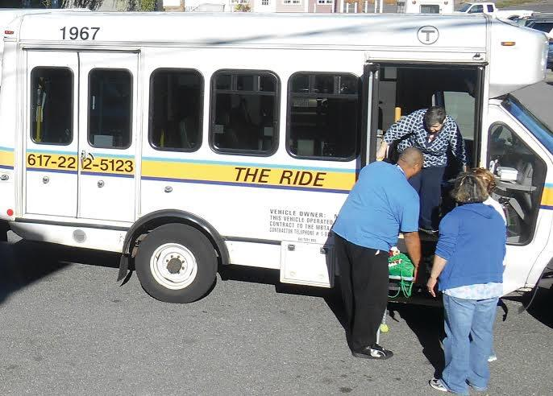
Workarounds/Solutions
Utilized applications for scheduling times/places
Split up the work in other ways
Stored addresses in a file, once converted did not have to geocode again
Met with TA (Alex) to find a way to install on the server
We all learned a lot!

Slide 14
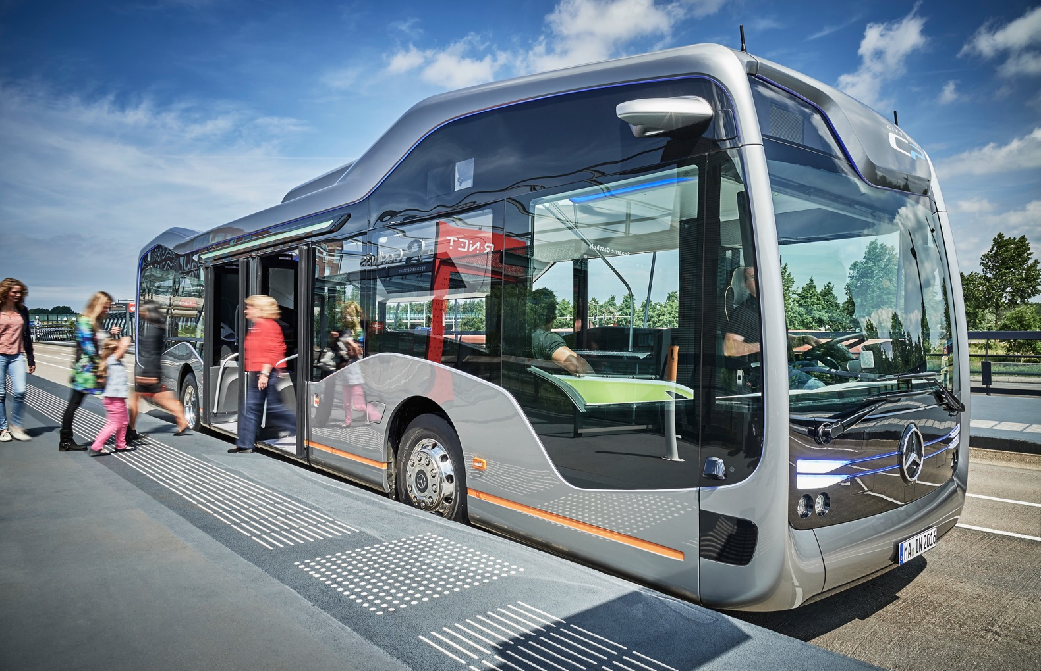
Future Additions
Assess cost analysis
Implement ability to change variables
time windows, average speed etc.
Utilize the verifone API
Automate tests using scripts
Use a database to store addresses used in previous routes and geocodes
Notes:
Sarah
Provide more metrics so the client can look at the data, include more stats, take cost into account (number of rides per hour) give more metrics to the client
In the future, we would like to implement the ability to change variables, such as time windows, and average speed. Currently, the algorithm does the average mph of the vehicle that can be changed
Also, we would like to utilize the verifone API as per the client’s request, we didn’t have time to look into it, but in the future we would try to utilize it.
If we had more time, we would automate our tests by writing test scripts, instead of having to manually write out tests like we did
Also, in the future, we would hopefully have a database to keep track of previous schedules to look back at what you’ve done

Slide 15
References
Geocoding
https://developers.google.com/maps/documentation/distance-matrix/start
Google Optimization Tools:
https://developers.google.com/optimization/routing
Genetic Algorithm and Routing problems
https://link.springer.com/chapter/10.1007/978-3-319-01622-1_45
Flask
http://flask.pocoo.org/
Notes:
Lindsay

Slide 16
Questions?

